Slide 1
Video Games
By Skye Hillhouse

Slide 2
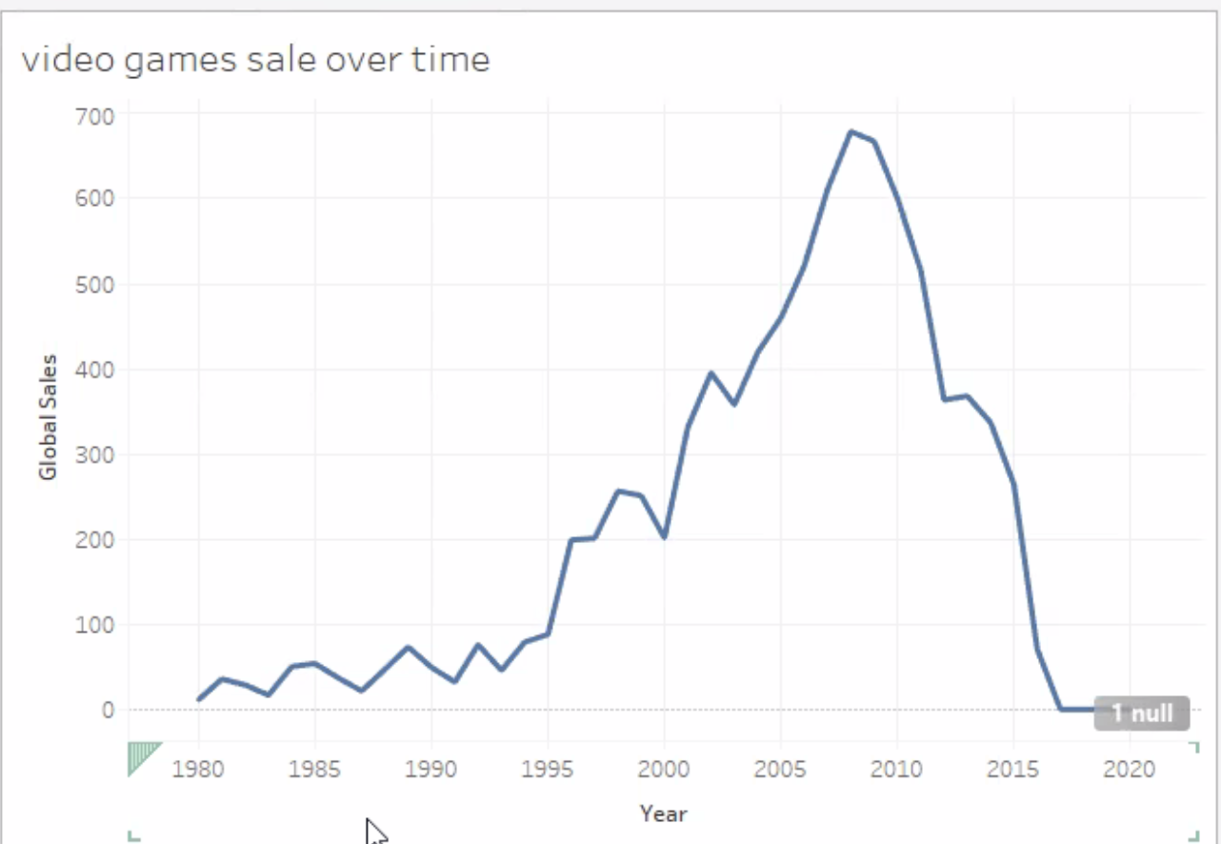

Slide 3
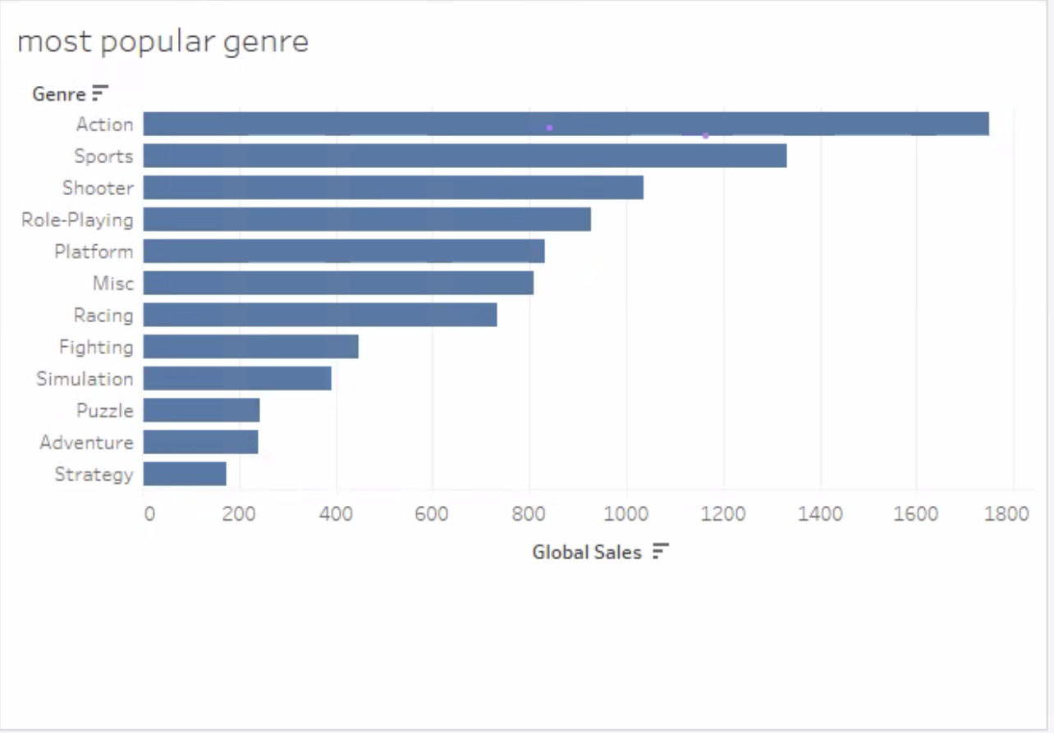
Obviously we like to get the adrenaline pumping

Slide 4
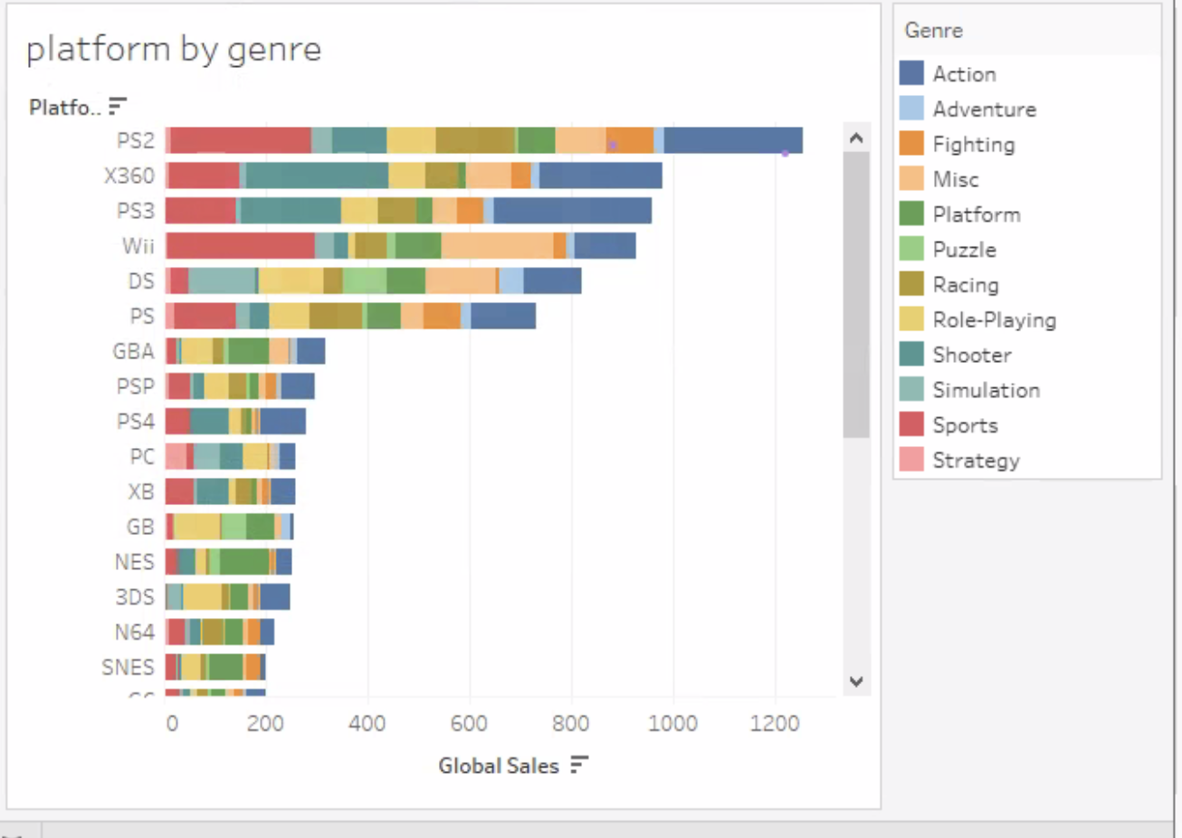

Slide 5
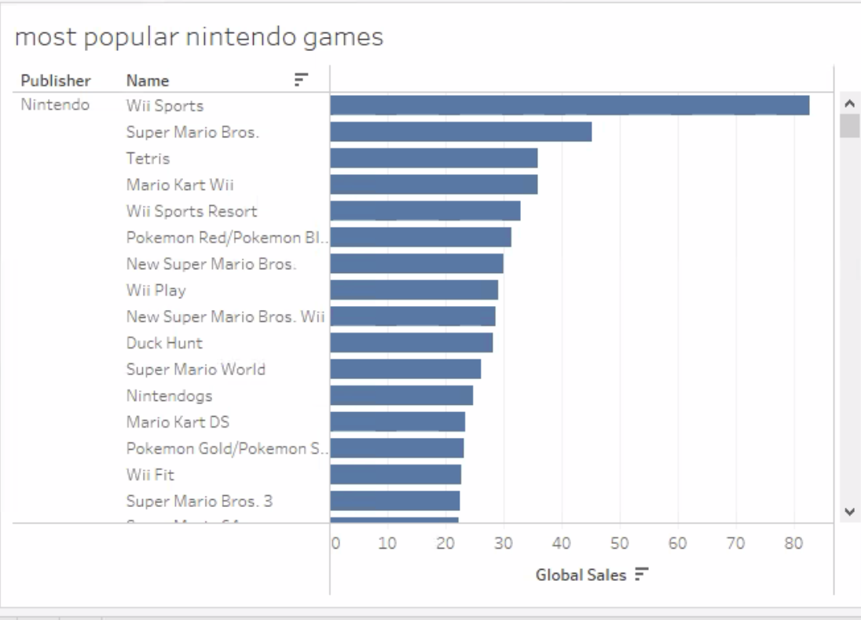
Nintendo
Games

